Slide 1

Cyclistic Bike-Share
Case Study
March 15, 2024
Presented by: Tristan Ramos

Slide 2

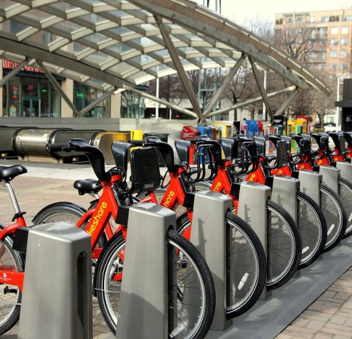
Contents
Introduction
Data Insights
Summary
Recommendations
Appendix

Slide 3
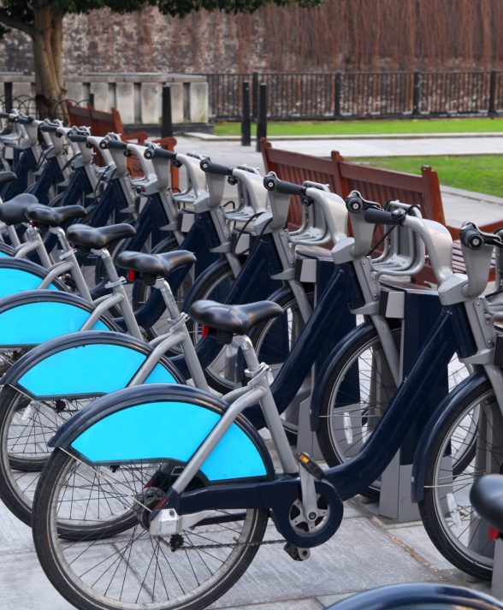
Statement of Business Task
Understand how do annual members and casual riders use Cyclistic bikes differently.
This comparison along with other tasks will later be used to design marketing strategies aimed at converting casual riders into members

Slide 4
Insights From Last Quarter 1 January 2019 - March 2020
Let’s dive in

Slide 5
Total Ride Share of Each User Group
Members have taken 82% more rides than casual users have overall. But still...
Insight #1
Number of rides taken by Members is 82% more than rides taken by Casual users.
However…

Slide 6
Average Duration of Rides
The casual bikers' average ride time is almost
Five times as much
compared to Members

Slide 7
Weekly Breakdown of Number of Rides
Insight #2
The number of Casual rides remain constant
Throughout the week.
The number of Member rides remain high throughout the week .

Slide 8
Weekly Breakdown of Average Ride Duration
Insight #3
The average ride duration of members stays consistent every week.
Thursdays during the week have the longest casual rider averages.
Is the rise in casual users during the week the reason for this high?

Slide 9
Casual Riders Weekday vs Weekend
For casual users, the number of rides does not change at the same rate as the average ride duration.
Nevertheless, the correlation is rather positive.
It shows weekend casual riders tend to take longer rides than weekday users.
Notes:
Number of rides and Average Duration of rides have a 0.6385 positive correlation.

Slide 10
Quarter 1 Comparison of Average Ride Duration
Insight #4
Average ride duration of casual riders increase and hits its peak on Jan and Feb

Slide 11
Let’s summarize the Insights

Slide 12




Summary
In general, casual bikers take fewer rides but stay on them longer.
Though they ride for 5 times longer, casual users take 82% fewer rides than members..
Bikes are primarily used for recreational purposes by casual riders.
The fact that casual riders utilize their bikes on weekend and holidays shows they use them for enjoyment, in contrast to members who are active throughout the quarter.
Casual Riders are most active on Weekdays and tend to take longer rides
3,000 increase in number of rides and 23 min increase on average duration of rides during weekdays
The longest rides are taken by casual bikers in January and February.
At its busiest in February, casual riders' average ride duration was eight times longer than that of members.
Notes:
Add chart

Slide 13

Recommendations
Now that we know how Casual users use bikeshare differently,
We Can:
Offer exclusive discounts and coupons to frequent and significant users if clients are charged based on ride duration. This will encourage users to take longer rides, which will increase income.
Create seasonal packages that enable casual riders to join up for membership for certain periods of time rather than committing to an annual subscription. This gives flexibility to the program.
Effective and efficient promotions by targeting casual riders at the busiest times and stations
Days: Weekends
Months: January and February
Stations: Streeter Dr & Grand Ave, Lake Shore Dr & Monroe St, Shedd Aquarium
Notes:
A chart of top 5 stations used by casual riders is attached in appendix

Slide 14




THANK YOU!
Tristan Ramos
Tristan.ramos0531@gmail.com
Github.com/tristan0531

Slide 15

Appendix

Slide 16

Datasets
Data used for this analysis is a sample of datasets made available by Motivate International Inc. on this link under this license
Top 5 Stations used by Casual Users
Click here to view the chart

Slide 17
Top 5 Stations used by Casual Riders

